Slide 1
CLASS 23
Dated 3 April , 2025
Course Title: 5G and Wireless Technology
Course Code : ECE829
MODULE 1 of the Syllabus:-
5G Waveform : OFDM, FBMC
Prof.(Dr.) Rabindranath Bera (Professor, IIIT, KALYANI)
E-mail: rbera@iiitkalyani.ac.in; Mobile : 9475513358
i

Slide 2
5G Waveform : 1. OFDM ( Orthogonal Frequency Division Multiplexing) 2. FBMC (Filter Bank Multi Carrier)

Slide 3
Outline of The Presentation
What is OFDM? [Orthogonal Frequency Division Multiplexing]
OFDM WAVEFORM Uses in 5G ; COMMERCIAL AVAILABILITY in 5G SMARTPHONE
ADVANTAGES of OFDM
DETAILS of OFDM
FBMC ( Filter Bank Multi Carrier)
NOMA ( Non Orthogonal multiple Access)

Slide 4
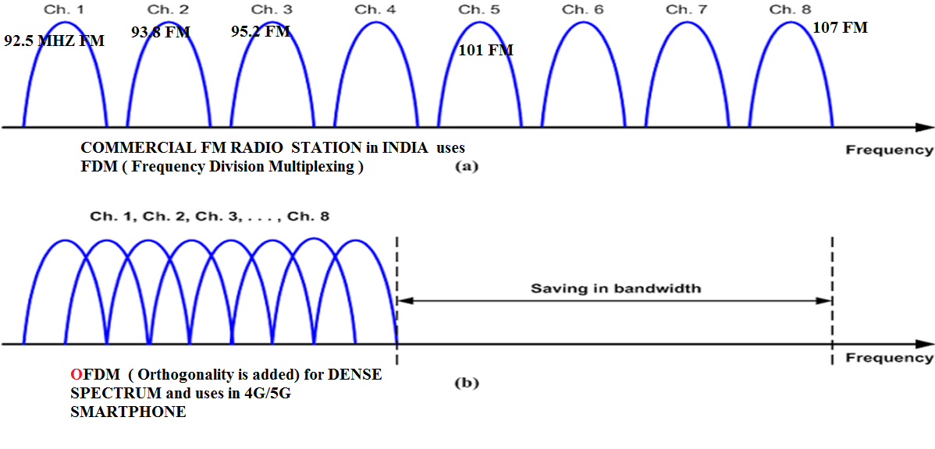
** OFDM uses DENSE SPECTRUM and Improves Spectral Efficiency * Please Remember ‘FDM Vs. OFDM ’
What is OFDM? Radio Carrier

Slide 5

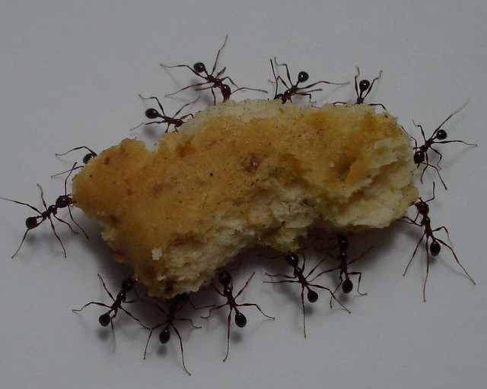
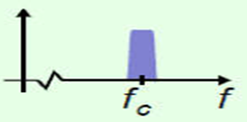
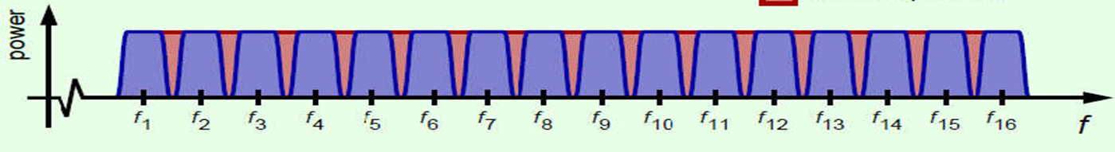
What is OFDM?
SINGLE NATURAL CARRIER
MULTIPLE NATURAL CARRIER
SINGLE ELECTRONIC CARRIER for
3G Mobile or FM RADIO
MULTIPLE ELECTRONIC CARRIER ( OFDM) for 4G/5GMobile
** fc is the RADIO CARRIER

Slide 6
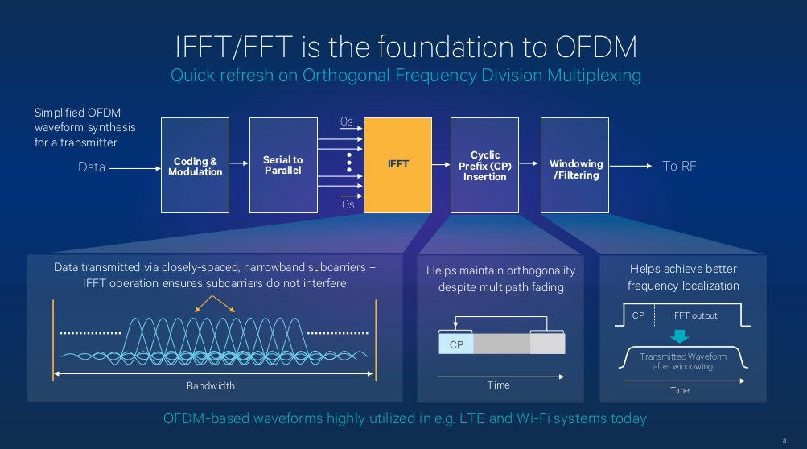

Slide 7
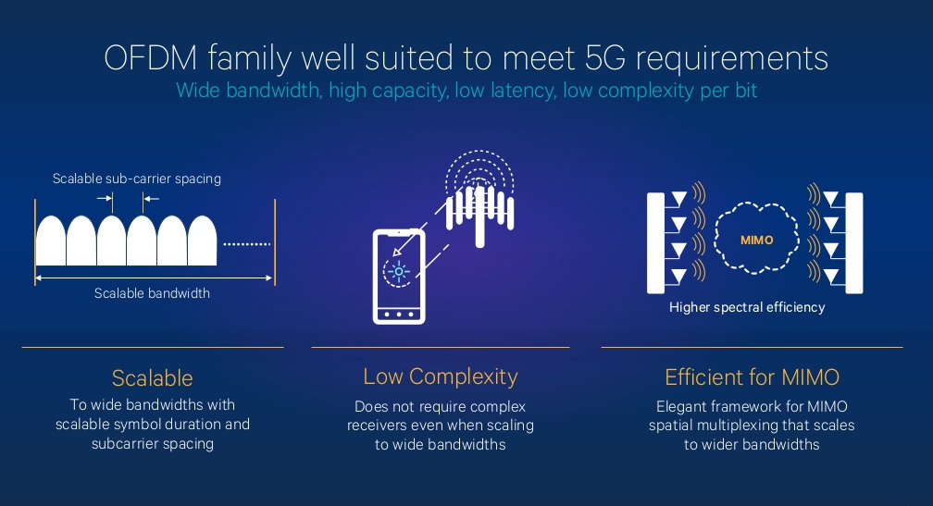

Slide 8
Orthogonal Frequency Division Multiplexing
OFDM is a digital transmission technique which is capable of achieving high spectral efficiency in multipath fading channels.
OFDM splits the available spectrum into a number of narrowband transmission channels known as subcarriers.
The data to be transmitted is distributed across all of the subcarriers for transmission.
At the receiver, the data streams received on all subcarriers are merged together to form a single data stream.

Slide 9
Multipath fading channels

Slide 10
Frequency Selective Fading

Slide 15
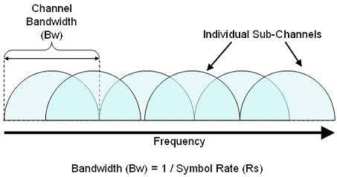
Orthogonal Subcarriers

Slide 16
Orthogonal subcarrier generation

Slide 18
In OFDM, different symbols are transmitted on different frequencies, rather than at different times.
Therefore, we must control inter-carrier-interference (ICI) in the frequency domain as well as ISI in time domain.
A rectangular time domain pulse has zero crossing in the frequency domain at the multiples of 1/T Hz, where T is the length of the pulse.
Thus the carriers are chosen to be placed at 1/T Hz separation to avoid ICI.
The process of generating a time domain signal from its frequesncy domain description is referred to as Inverse Fourier Transform (IFT).
Additionally, an Inverse Discrete Fourier Transform (IDFT) produces a set of tones with the desired frequency spacing to achieve the orthogonality.

Slide 19
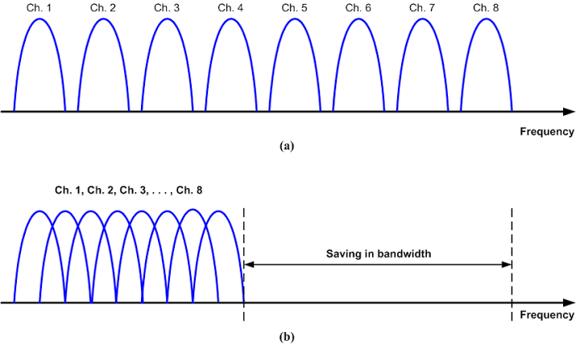
Spectral Efficiency

Slide 21
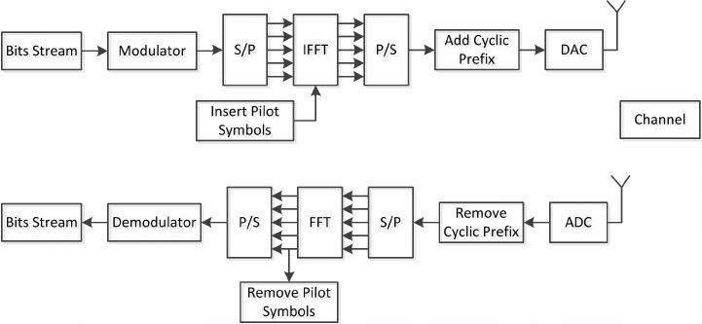
OFDM Tx-RX Block Diagram

Slide 22
Presentation on
MULTICARRIER
MODULATION
OFDM — FBMC

Slide 23
Presentation Outline
□ Multicarrier Modulation
□ OFDM
□ Introduction
□ System model
□ FBMC
□ Introduction
□ System model
□ Comparison between OFDM vs FBMC
□ Conclusion & Research Scopes

Slide 24
Multicarrier modulation
• Originally MCM required the use of several channels that were separated from each other by the use of steep sided filters of they were close spaced.
• In this way, interference from the different channels could be eliminated.
Frequency

Slide 25
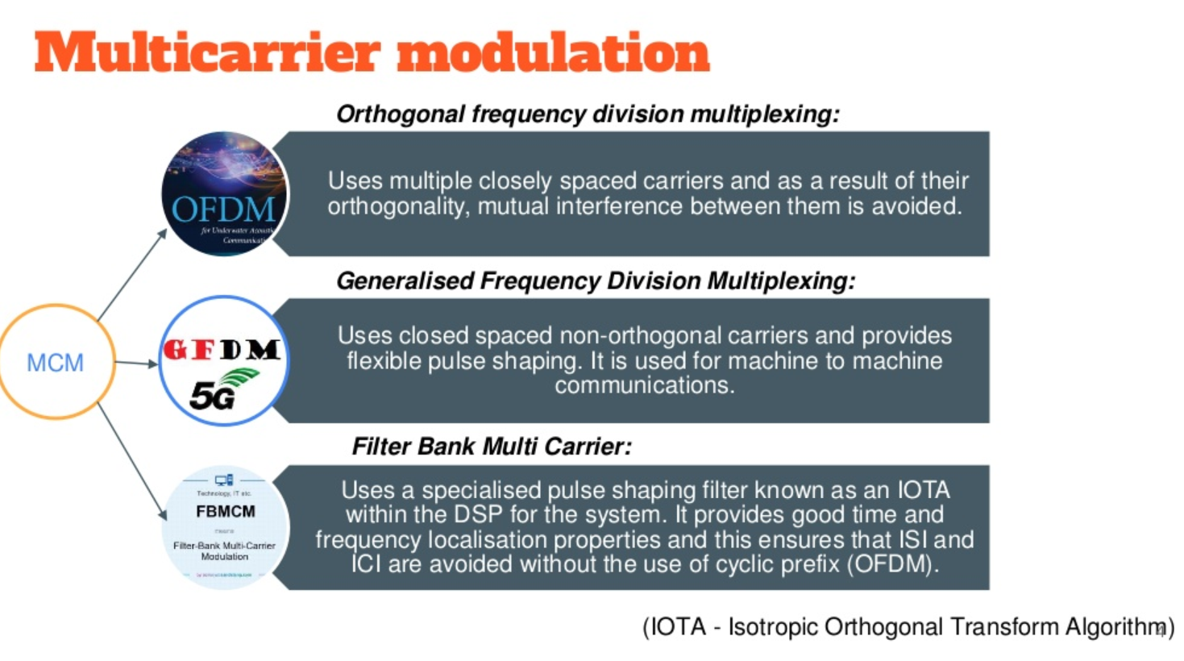

Slide 26
FBMC:
FBMC is a multicarrier modulation technique that utilizes filter banks to achieve high spectral efficiency and robustness against inter-carrier interference (ICI).
IOTA:
IOTA is a pulse-shaping algorithm used in FBMC systems to improve the system's performance, especially in scenarios with high delay spread.

Slide 27
OFDM
Orthogonal frequency-division multiplexing is a method of encoding digital data on multiple carrier frequencies
which are orthogonal to each other

Slide 28
OFDM
• With fast data transmissions, line noise and other interference frequently occurs.
• There will usually be much less interference when data is sent at a slow rate.
• The idea is to send many small pieces of data at the same time, which are later to be combined into a single unit.
• In the case of OFDM, data is broken into many subcarrier streams (up to 52) and then multiplexed into one individual data stream.

Slide 29
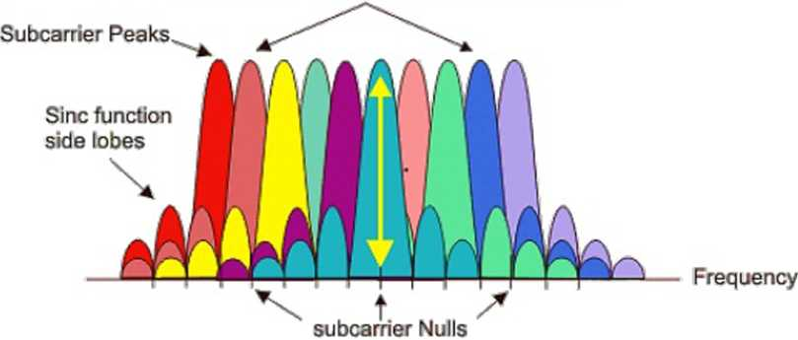
OFDM
• OFDM uses processing power within the • Closely spaced subcarriers overlap,
receiver and orthogonality between the Subcarrier nulls correspond to peaks of
carriers to ensure no interference was adjacent subcarriers for zero ICI
present
Orthogonally spaced overlapping subcarriers
Receiver will receive far more data in the same time period than using other data delivery methods
7

Slide 30
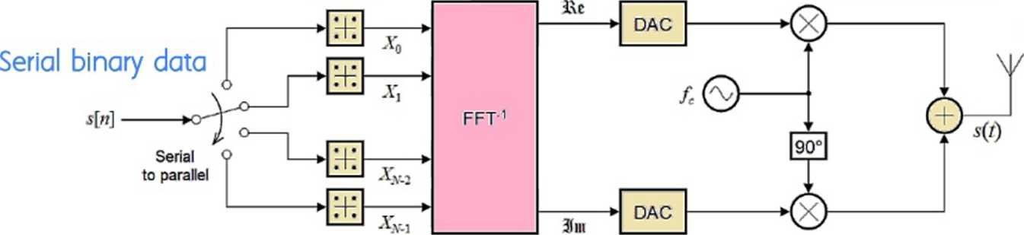
OFDM Tx - System Model
Inverse FFT
QAM/PSK gives output in complex
time domain samples
Quadrature Mixing & DAC=>Sine and Cosines Modulated to fc
Constellation
mapping
Transmitted
signal
8

Slide 31
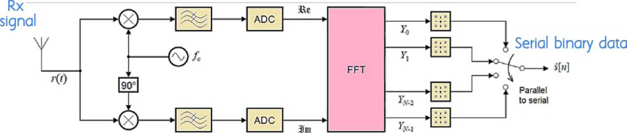
OFDM Rx - System Model
Quadrature downmixing &
" ADC=>Sine and Cosines Sampled &
demodulated digitised Symbol detection
LPF
To filter signals Centred at 2fc
Forward FFT Convert to Freq.Domain

Slide 32
FBMC
Filter Bank Multi-Carrier Modulation are evolved form of subband processing, harnessing the key advantages of original efficient subband processing based on Fast Fourier Transform and addressing some of OFDM’s shortcomings at the cost of increased implementation complexity.
10

Slide 33
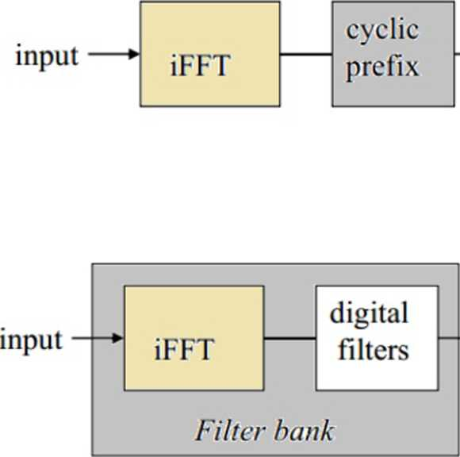
OFDM Tx
*• channel
FBMC Tx
♦ channel
11

Slide 34
The difference with OFDM is that, FBMC does not have a CP (Cyclic Prefix) which is a better use of spectrum. On the other hand, it is susceptible to ISI (Inter Symbol Interference) due to the absence of GI (Guard Interval) when transmitted over wireless channel
FBMC uses prototype filters to shape the out of band emission to lower the interference.
There is a concept of FBMC-OQAM (sometimes referred as staggered multitone or SMT), where the input signal is first converted to QAM symbols and further processed into OQAM symbols.

Slide 35
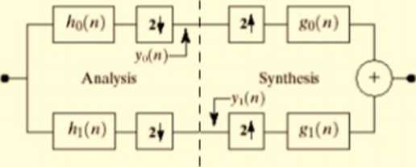
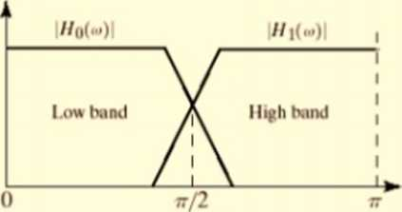
FBMC
• SIMPLE TWO BAND FILTER BANK

Slide 36
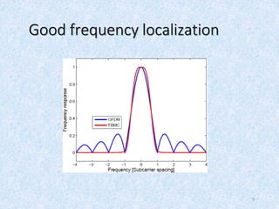

Slide 37
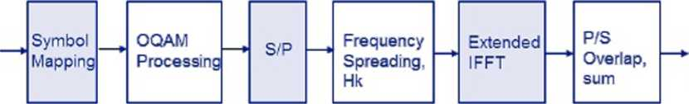
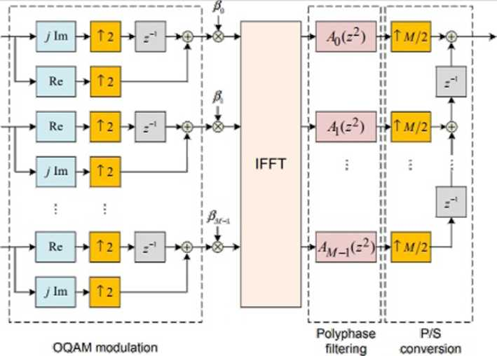
FBMC Transmitter
FBMC Tx
Data
Bits
To
Channel
• SYNTHESIS FILTERBANK
13

Slide 38
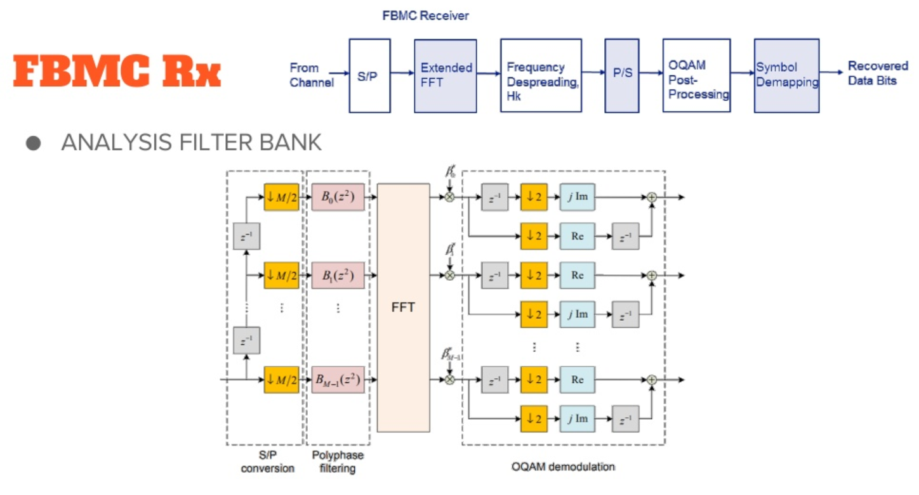

Slide 39
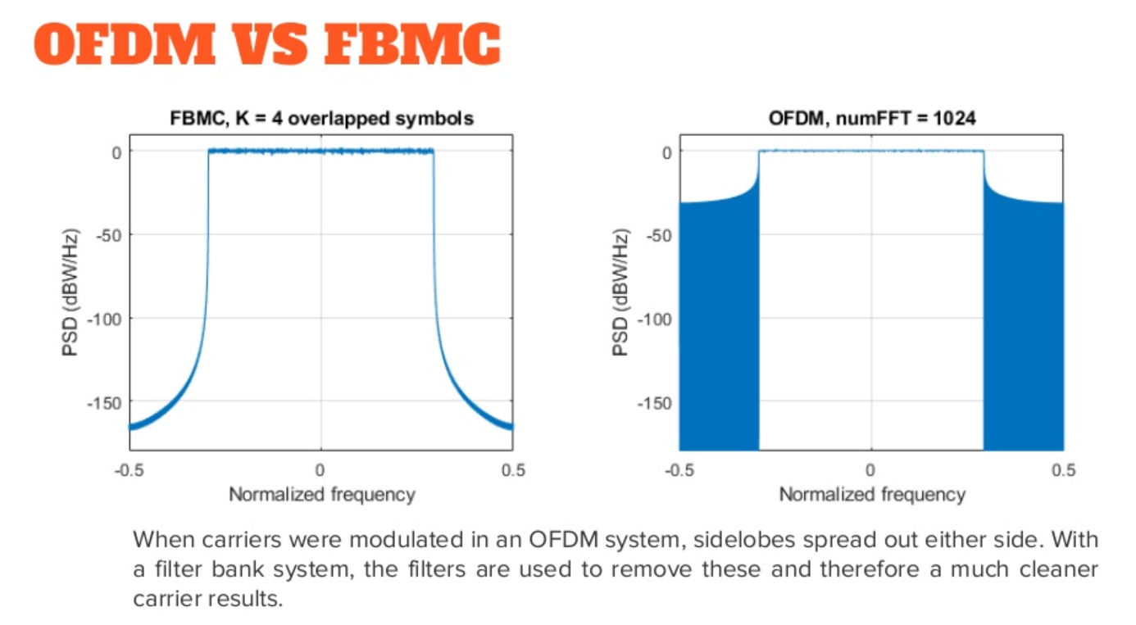

Slide 40
OFDM VS FBMC
OFDM | FBMC
Multicarrier system where data is broken into many orthogonal subcarrier streams | Multicarrier system based on filter banks at the Tx and Rx. Main Contender for 5G
CP extension required and therefore reduces Bandwidth (BW) efficiency | Not required and hence conserves BW
Large sidelobes in frequency sprectrum | Smaller and sharper sidelobes than ofdm
Multiple access interference (MAI) cancellation should be performed at the receiver | MAI is suppressed due to the excellent frequency localization of the subcarriers in FBMC
16

Slide 41
OFDM VS FBMC
OFDM | FBMC
High flexibility while adopting MIMO techniques | FBMC is less flexible for MIMO
Degraded spectrum sensing performance due to the spectral leakage in OFDM signals | High spectrum sensing resolution in FBMC
OFDM is Less complex in implementation | Quite complex to implement
Highly sensitive to the carrier frequency offset in OFDM | Less sensitive and hence performs significantly with the increase of the user mobility

Slide 42
Conclusion
• FBMC is considered advantageous in comparison to OFDM by offering higher spectral efficiency.
• Due to the per subcarrier filtering, it incurs a larger filter delay and also requires OQAM processing, which requires modifications for MIMO processing.
18

